Slide 1
Sigma Dataset Introduction

Slide 2
Agenda
Introduction to Sigma Datasets
SigmaRunSummary
SigmaLotSummary
SigmaWaferSummary
SigmaMeasurementSummary
SigmaPoint
SigmaPointLocation
SigmaHistory
YieldCube Global Query
Teradata
HBase
Data Daemon

Slide 3
Note
We will use Teradata as reference to illustrate how Sigma tables look like.
NEXUS Table is used.
Databases → SYSDBA → ACTIVE_AREA → PROD → DM → WW_MFG_DM →Views
HBase data table structure is very similar.

Slide 4
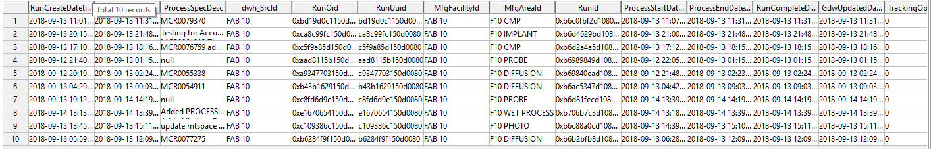
Sigma Datasets
sigma_run
dwh_SrcId: fab information
MfgAreaId: Process area information
RunCompleteDatetime: Run complete datetime, normally this is used for time range filter.
RunOid: Join key with sigma_run_summary
RunId: Run id generated by the system in fab.
SELECT * FROM WW_MFG_DM.SigmaRunSummary SAMPLE 10
WHERE dwh_SrcId = 'FAB 10'
and RunCompleteDatetime > '2018-09-13 00:00:00';

Slide 5
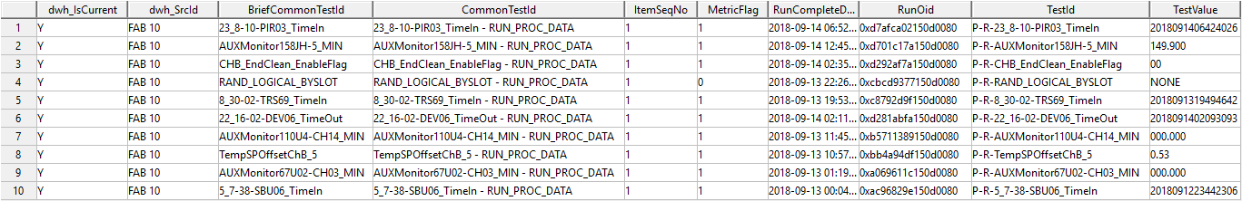
Sigma Datasets
sigma_run_summary
dwh_SrcId: fab information
CommonTestId: Item name
TestValue: Item value
RunCompleteDatetime: Run complete datetime, normally this is used for time range filter.
SELECT * FROM WW_MFG_DM.SigmaRunSummary SAMPLE 10
WHERE dwh_SrcId = 'FAB 10'
and RunCompleteDatetime > '2018-09-13 00:00:00';

Slide 6
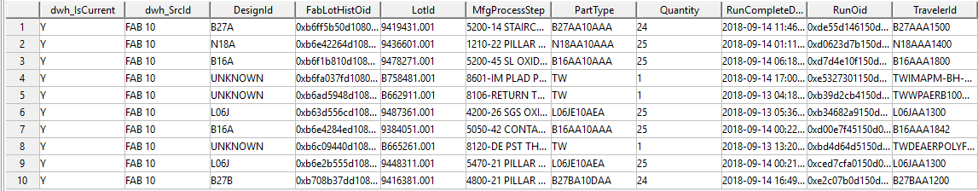
Sigma Datasets
sigma_lot
dwh_SrcId: fab information
MfgProcessStep: MFG Process Step
DesignId: Design id
LotId: lot id used at this step
RunCompleteDatetime: Run complete datetime, normally this is used for time range filter.

Slide 7
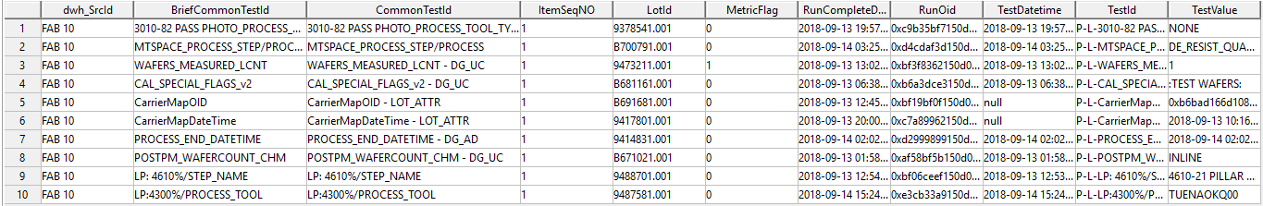
Sigma Datasets
sigma_lot_summary
dwh_SrcId: fab information
CommonTestId: Item name
LotId: lot id used at this step
TestValue: Item value
RunCompleteDatetime: Run complete datetime, normally this is used for time range filter.

Slide 8
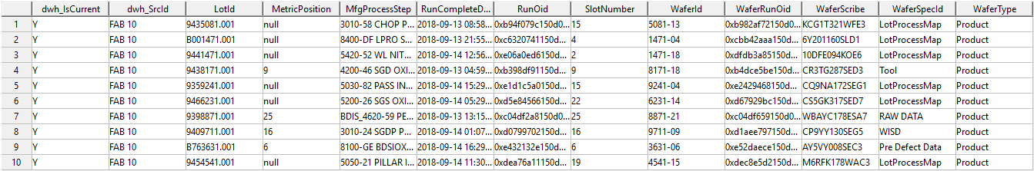
Sigma Datasets
sigma_wafer
dwh_SrcId: fab information
LotId: lot id used at this step
WaferId: wafer id used at this step
WaferScribe: wafer id used at this step
RunCompleteDatetime: Run complete datetime, normally this is used for time range filter.
WaferRunOid: Join key with sigma_wafer_summary

Slide 9
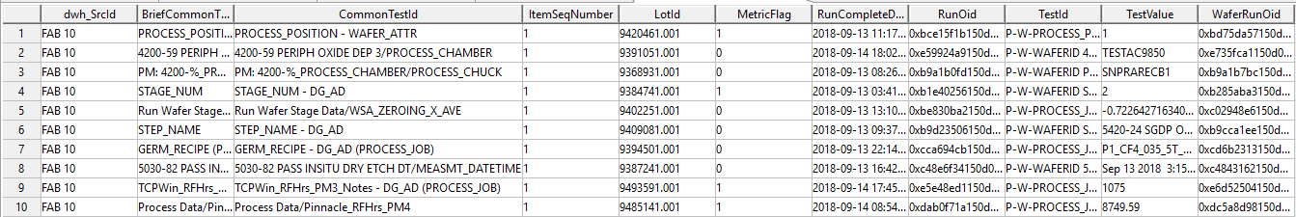
Sigma Datasets
sigma_wafer_summary
dwh_SrcId: fab information
CommonTestId: Item name
LotId: lot id used at this step
TestValue: Item value
RunCompleteDatetime: Run complete datetime, normally this is used for time range filter.
WaferRunOid: Join key with sigma_wafer

Slide 10
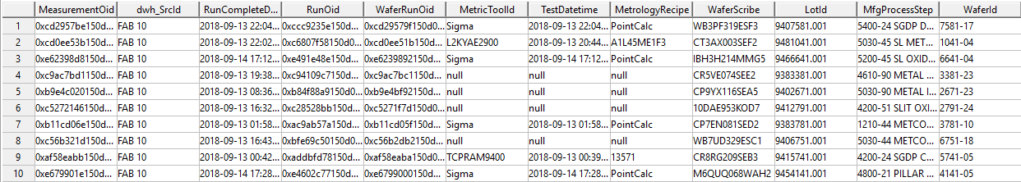
Sigma Datasets
sigma_measurement
dwh_SrcId: fab information
LotId: lot id used at this step
WaferId: wafer id used at this step
WaferScribe: wafer id used at this step
RunCompleteDatetime: Run complete datetime, normally this is used for time range filter.
WaferRunOid: Join key with sigma_wafer
MeasurementOid: Join key with sigma_measurement_summary

Slide 11
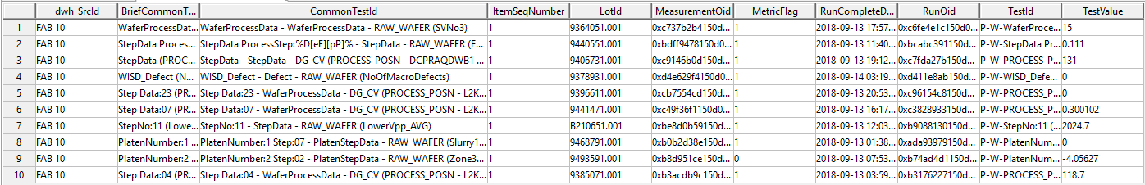
Sigma Datasets
sigma_measurement_summary
dwh_SrcId: fab information
CommonTestId: Item name
LotId: lot id used at this step
TestValue: Item value
RunCompleteDatetime: Run complete datetime, normally this is used for time range filter.
MeasurementOid: Join key with sigma_measurement

Slide 12
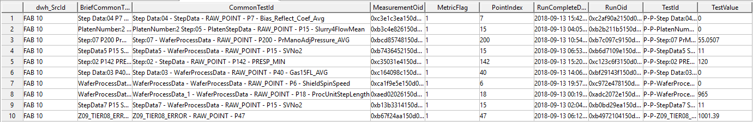
Sigma Datasets
sigma_point
dwh_SrcId: fab information
CommonTestId: Item name
TestValue: Item value
PointIndex: Measurement point index number
RunCompleteDatetime: Run complete datetime, normally this is used for time range filter.
MeasurementOid: Join key with sigma_measurement

Slide 13
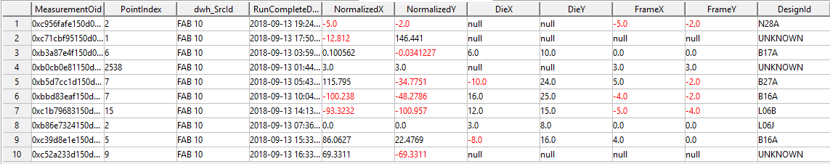
Sigma Datasets
sigma_point_location
dwh_SrcId: fab information
PointIndex: Measurement point index number, can join with sigma_point
RunCompleteDatetime: Run complete datetime, normally this is used for time range filter.
DesignId: Design Id.
NormalizedX: X coordinate on wafer (-150 to 150)
NormalizedY: Y coordinate on wafer (-150 to 150)
DieX: die index in X direction
DieY: die index in Y direction
FrameX:
FrameY:

Slide 14
Common Items
MFG_PROCESS_STEP → SigmaLot
EQUIPMENT_ID → SigmaRun
DESIGN_ID → SigmaLot
PROCESS_ID → SigmaLot
CHAMBER → SigmaWaferSummary, CommonTestId = ‘PROCESS_CHAMBER - WAFER_ATTR’
RECIPE → SigmaRunSummary, CommonTestId = ‘GeRM RECIPE - RUN_ATTR’
SLOT → SigmaWaferSummary, CommonTestId = ‘WAFER_SLOT - DG_AD’
RUN_COMPLETE_DATETIME → SigmaRun

Slide 15
Applications

Slide 16
Query Methods
Application
Sigma History | To view sigma data
Yield Cube Global Query | To query data and do basic analysis in YieldCube
Teradata | For large amount of Sigma data query
Sigma HBase | For large amount of Sigma data query

Slide 17
Sigma History

Slide 18
Sigma History
Sigma History Training
Sigma History is suitable for quick check on certain Sigma data items.
Demo

Slide 19
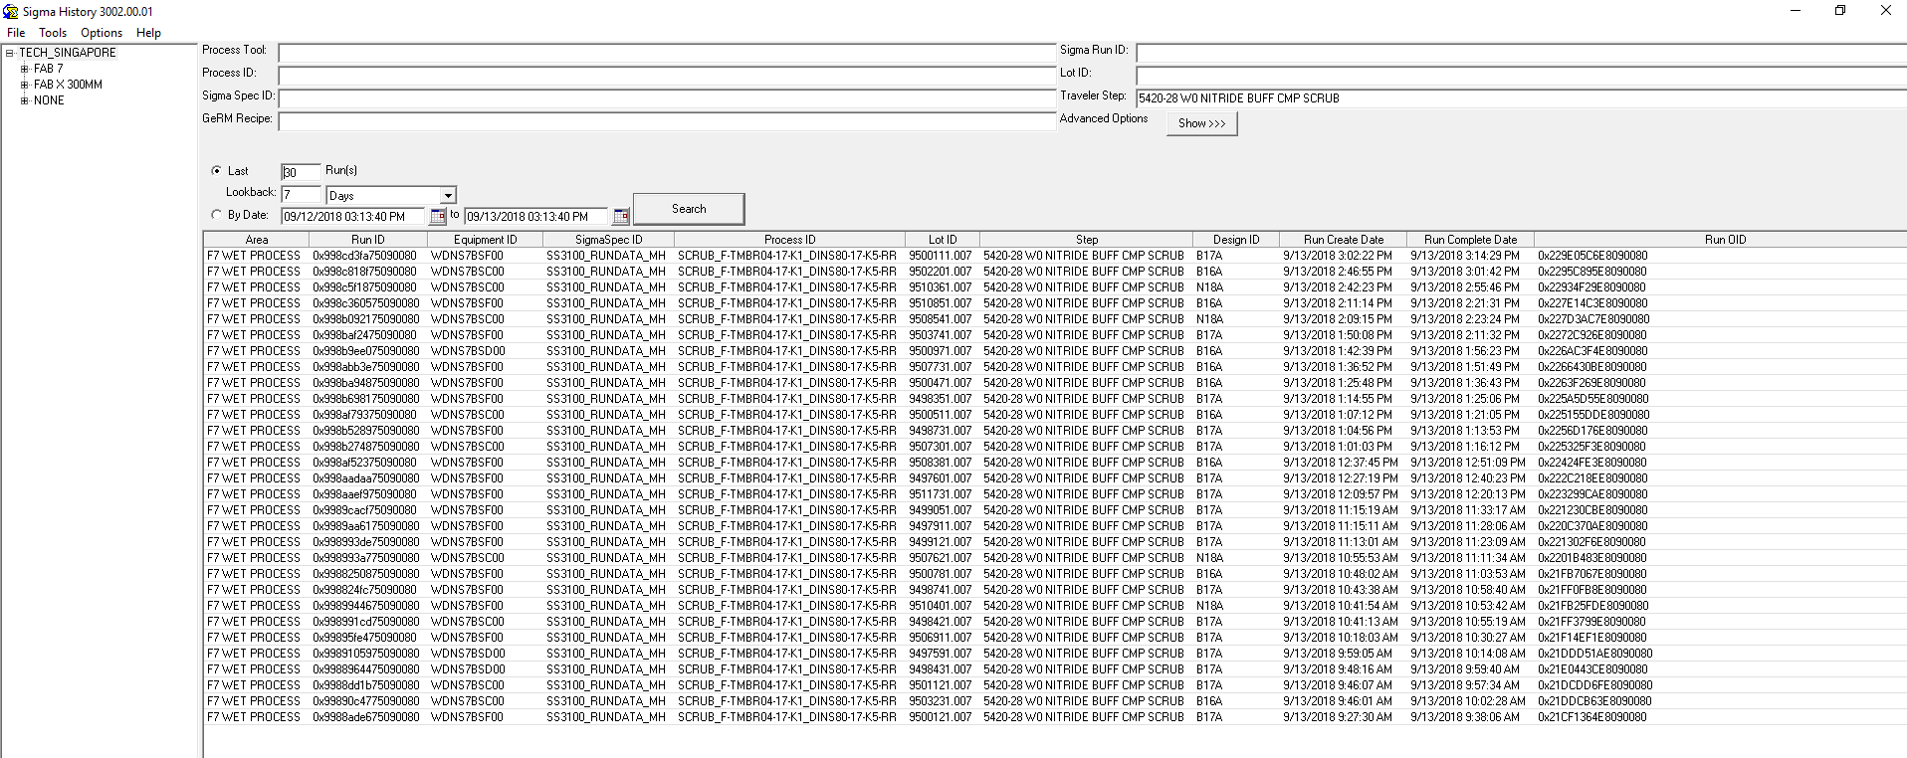
Sigma History

Slide 20
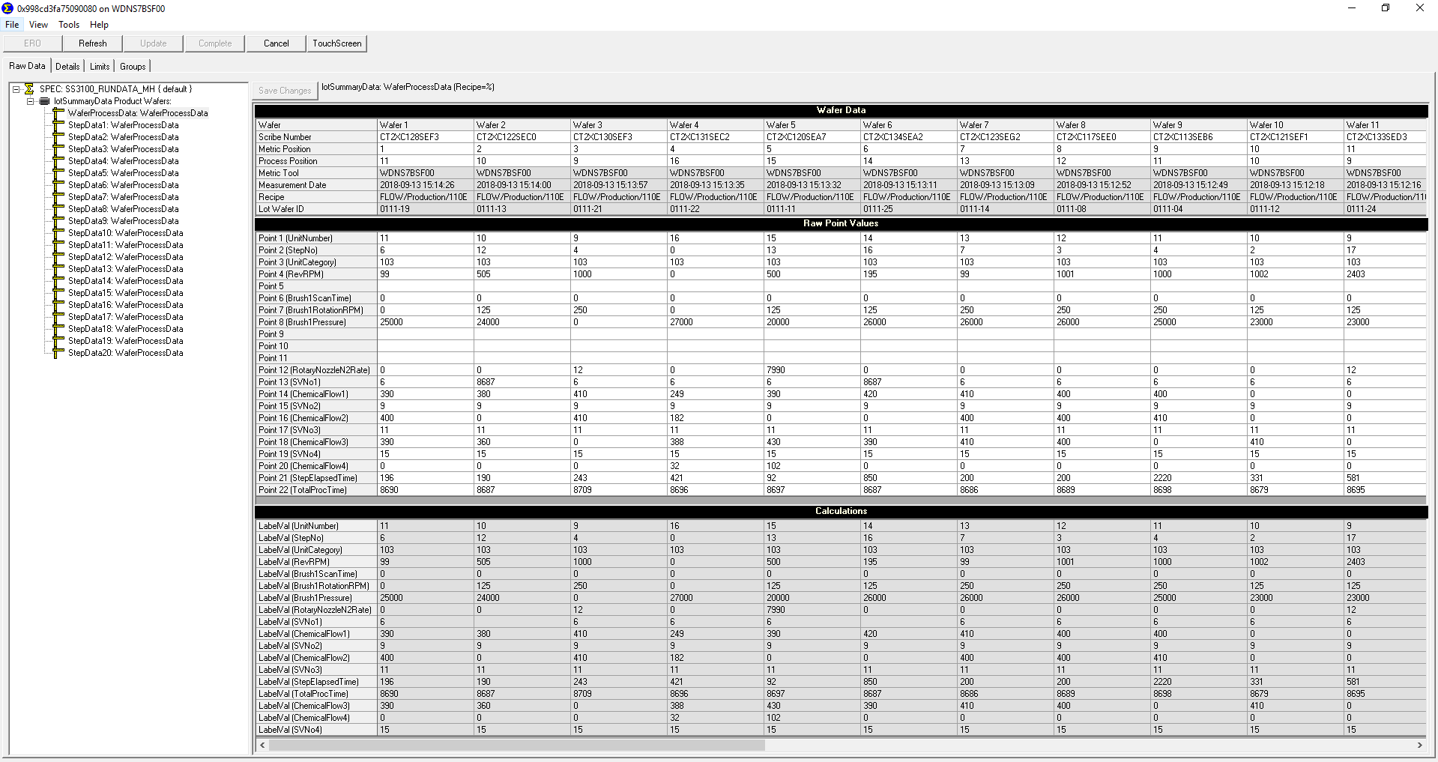
Sigma History

Slide 21
Sigma History

Slide 22
YieldCube

Slide 23
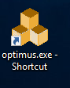
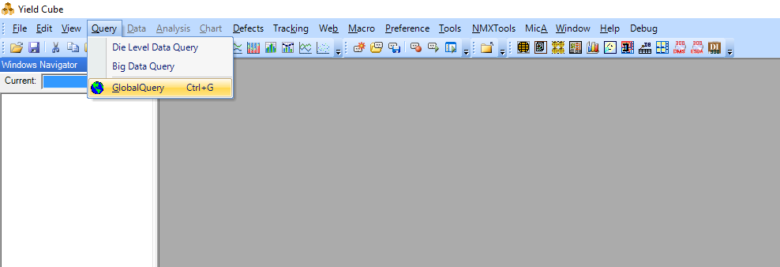
YieldCube Global Query
YieldCube Training

Slide 24
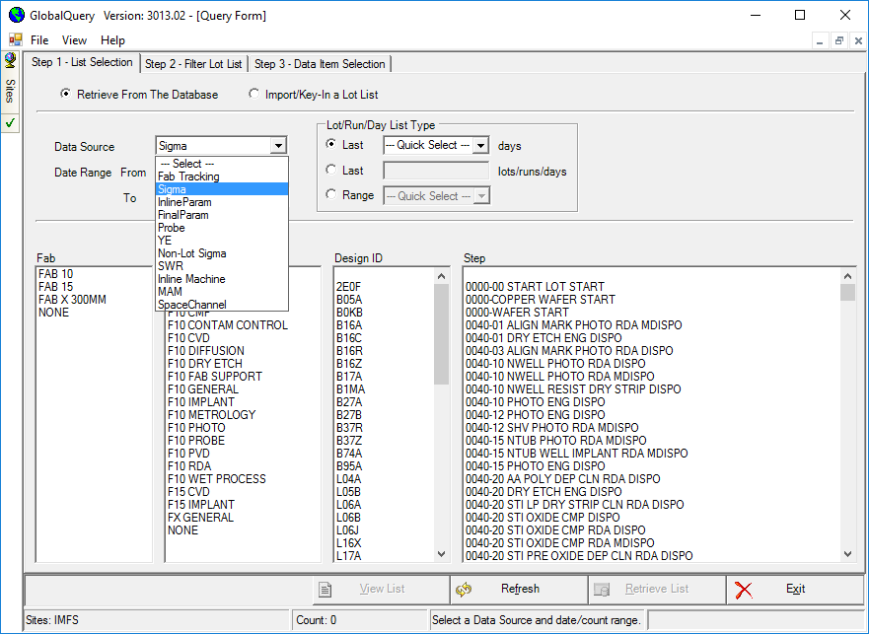
YieldCube Global Query

Slide 25
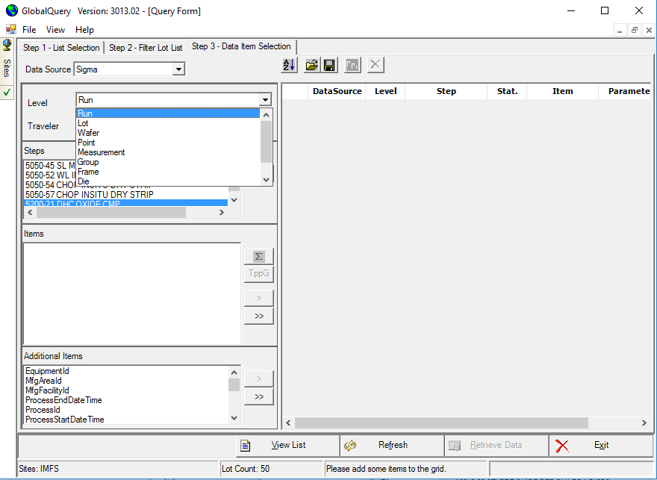
YieldCube Global Query

Slide 26
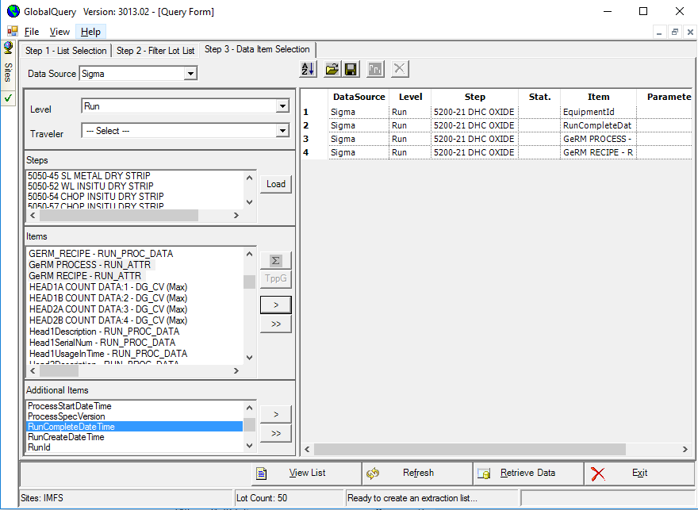
YieldCube Global Query

Slide 27
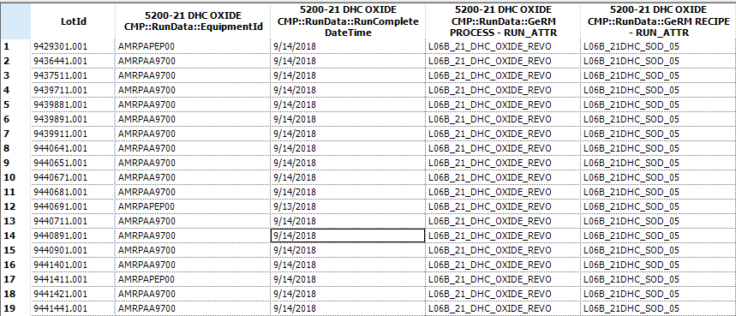
YieldCube Global Query

Slide 28
HBase

Slide 29
HBase

Slide 30
Data Daemon

